Slide 1
BT233 – General Microbiology Laboratory
Bacterial Purification and Colony Morphology

Slide 2
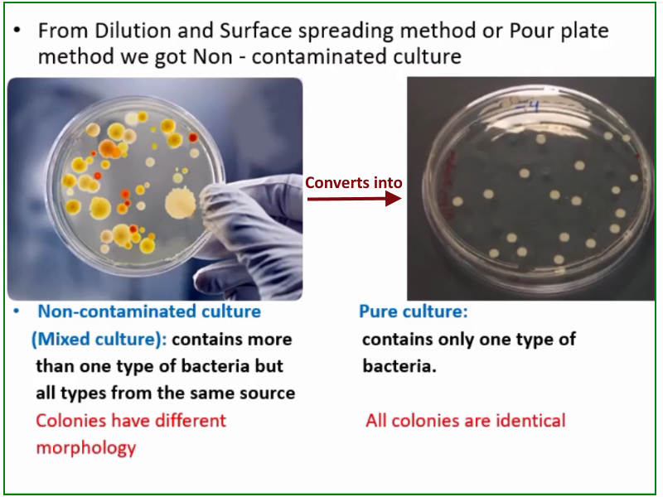

Slide 3
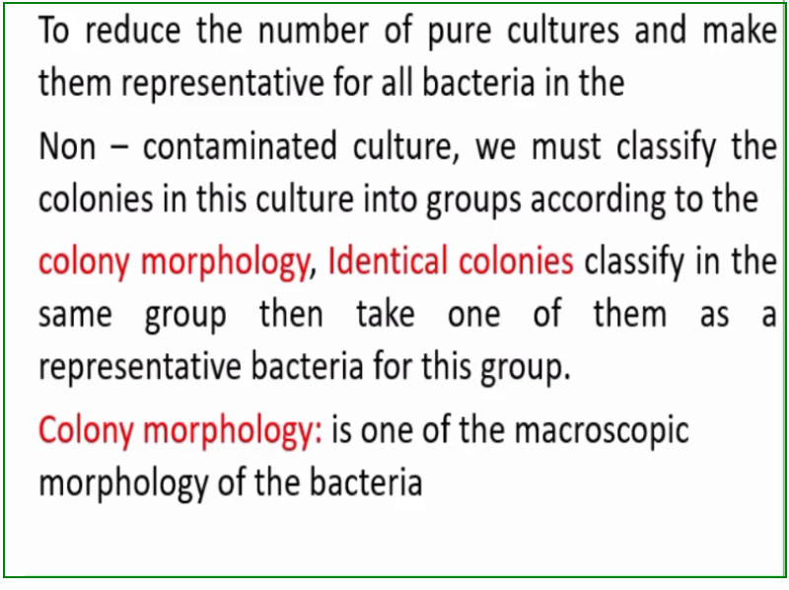

Slide 4
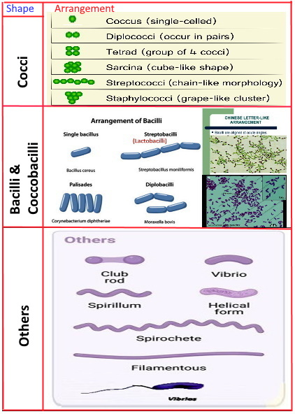
Bacterial Characteristics
There are two types of bacterial
characteristics:
A- Microscopic characters: it’s the bacterial morphologies that we can’t see them by the naked eyes(Unaided eyes), these include Shape of bacterial cells and their arrangement as in the behind picture.

Slide 5
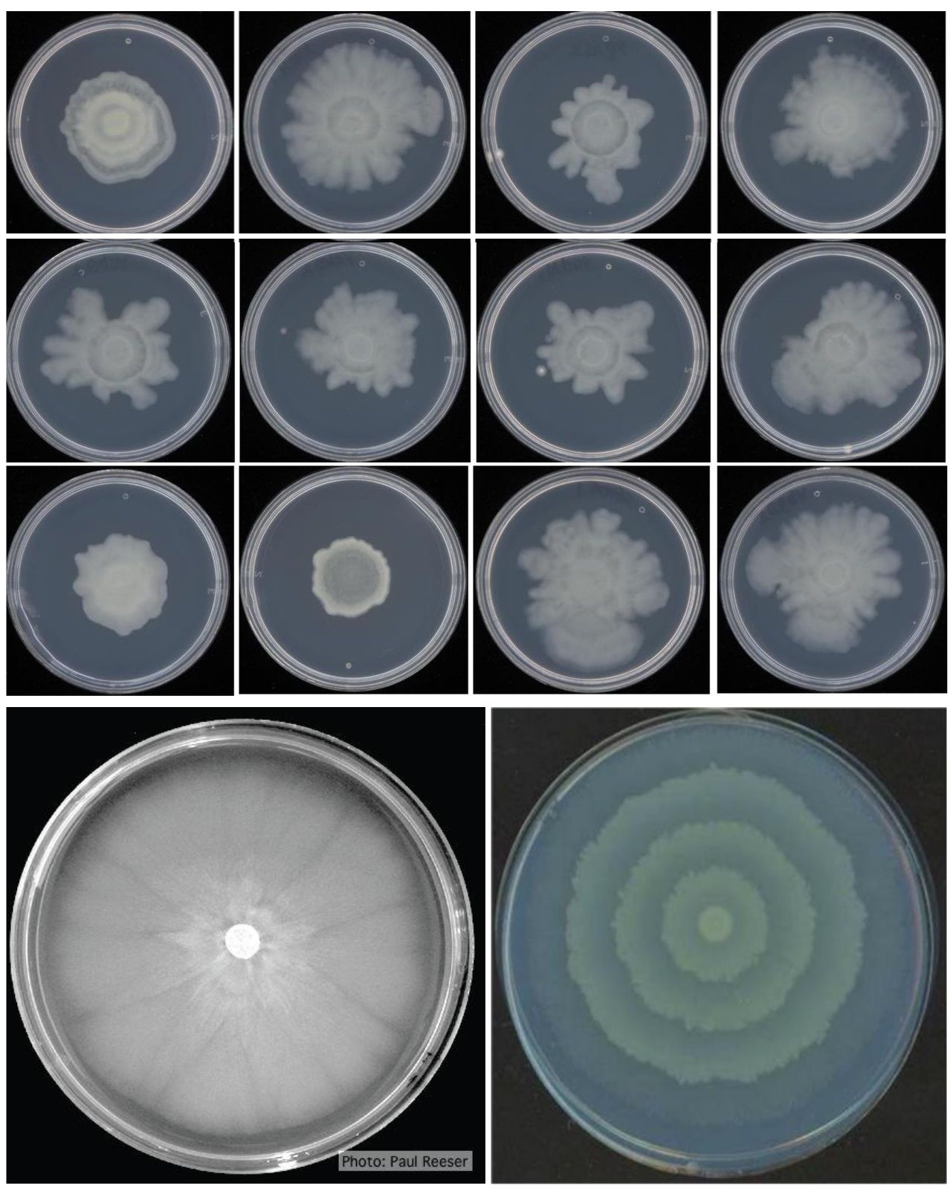
Bacterial Characteristics
B- Macroscopic characters: it’s the bacterial morphology that we can see them by the naked eyes(Unaided eyes), this includes:
Colony morphology
Bacterial Growth morphology.

Slide 6
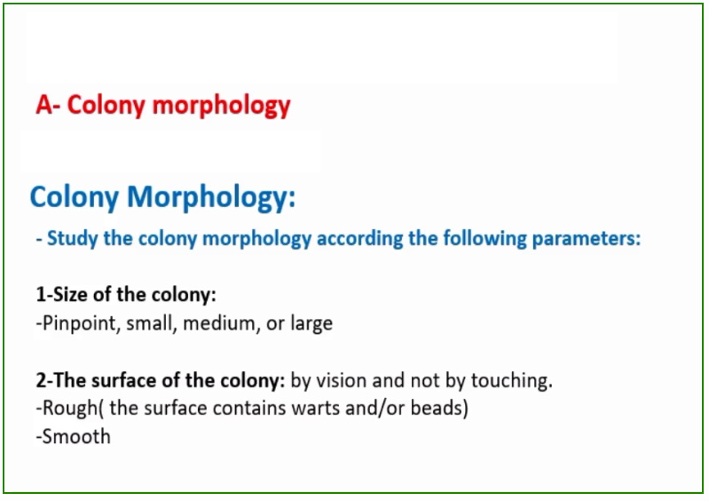

Slide 7
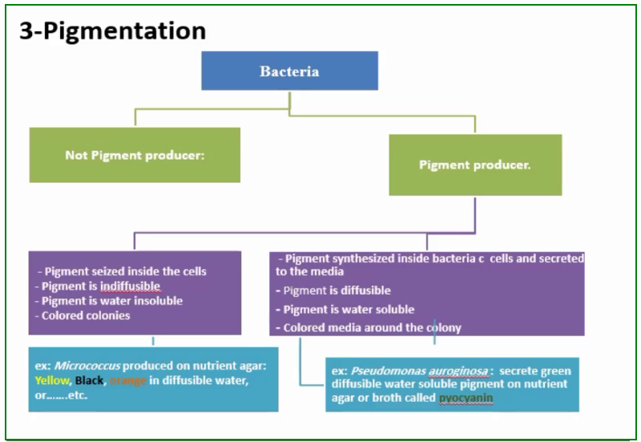

Slide 8
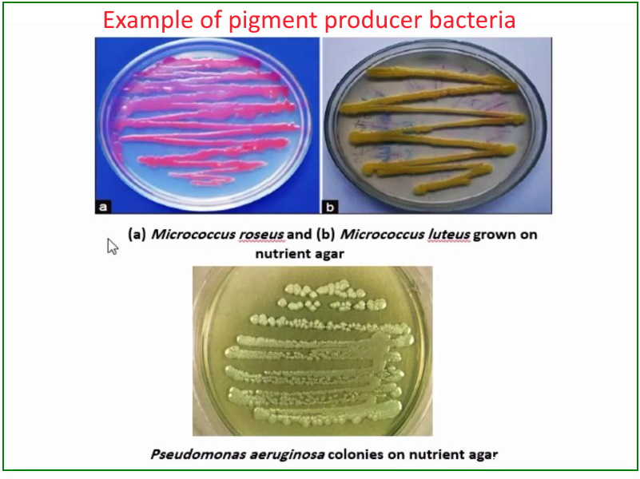

Slide 9
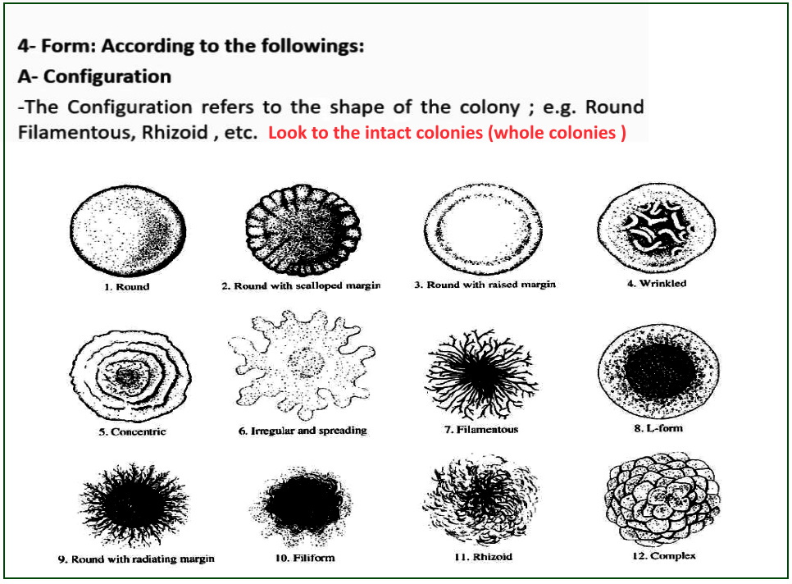

Slide 10
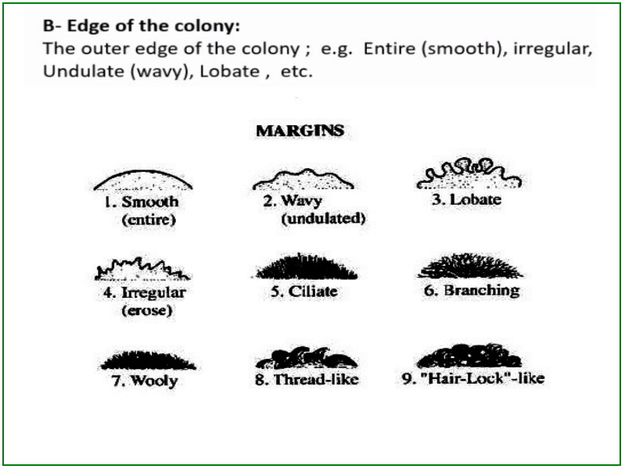

Slide 11
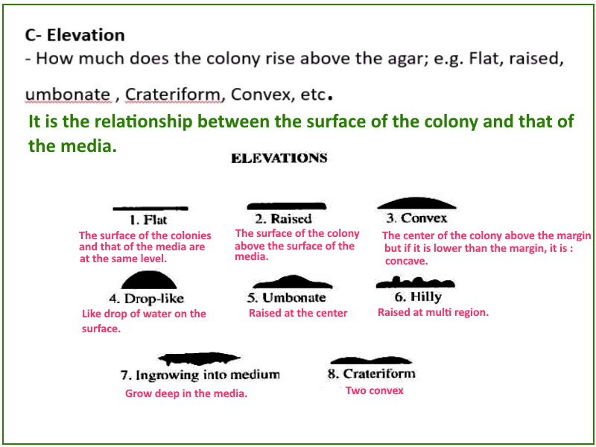

Slide 12
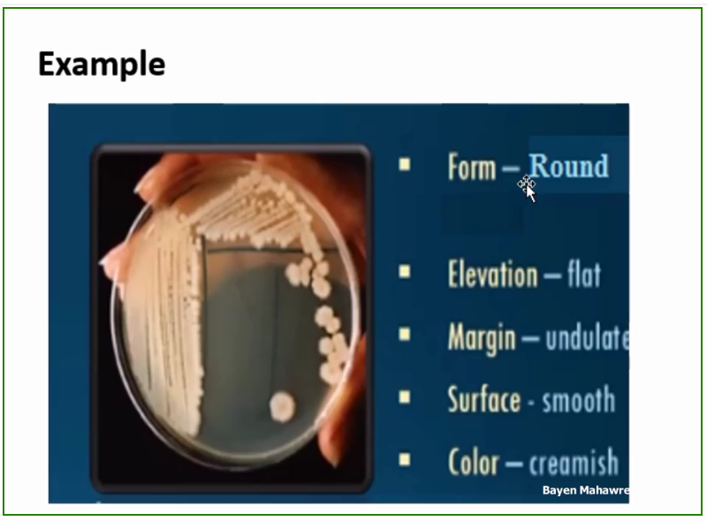

Slide 13
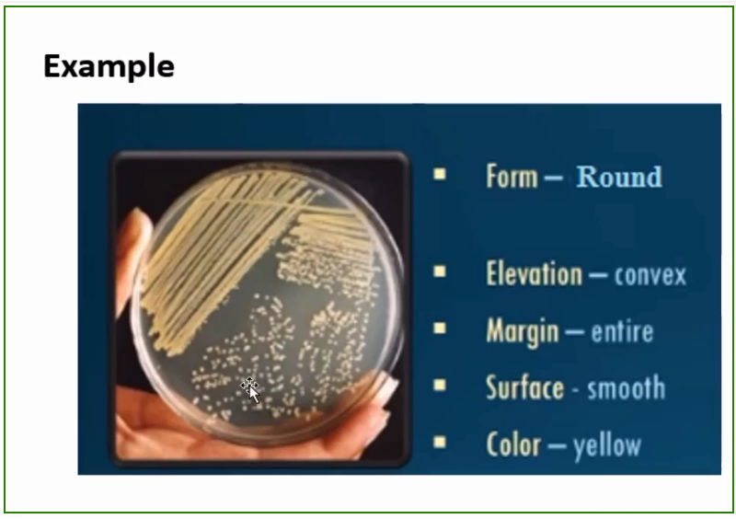

Slide 14
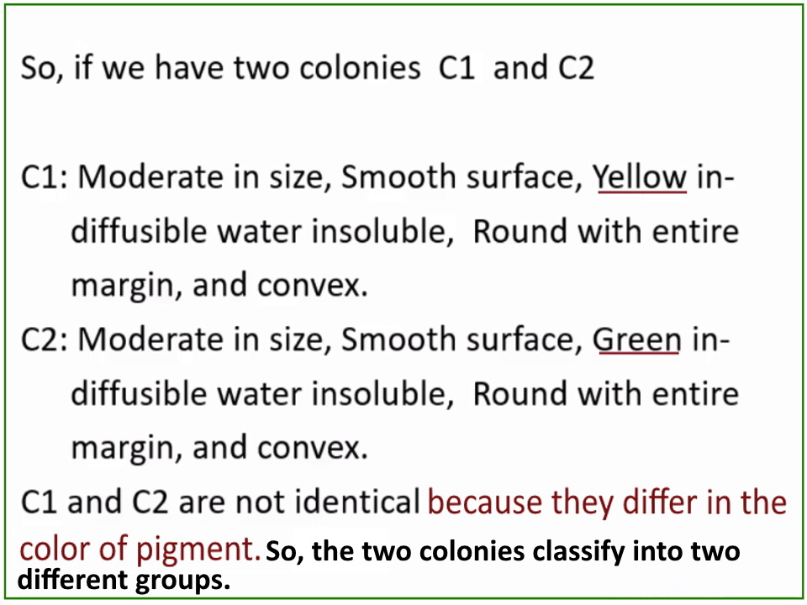

Slide 15
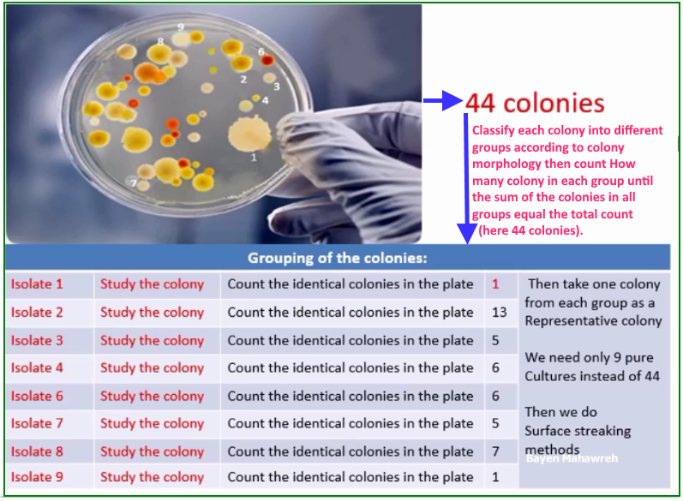

Slide 16
Surface streaking methods
There are four different streaking methods for purification of bacteria,
these are:
Quadrant method
T- Streaking
Radiant streaking
Continuous streaking

Slide 17
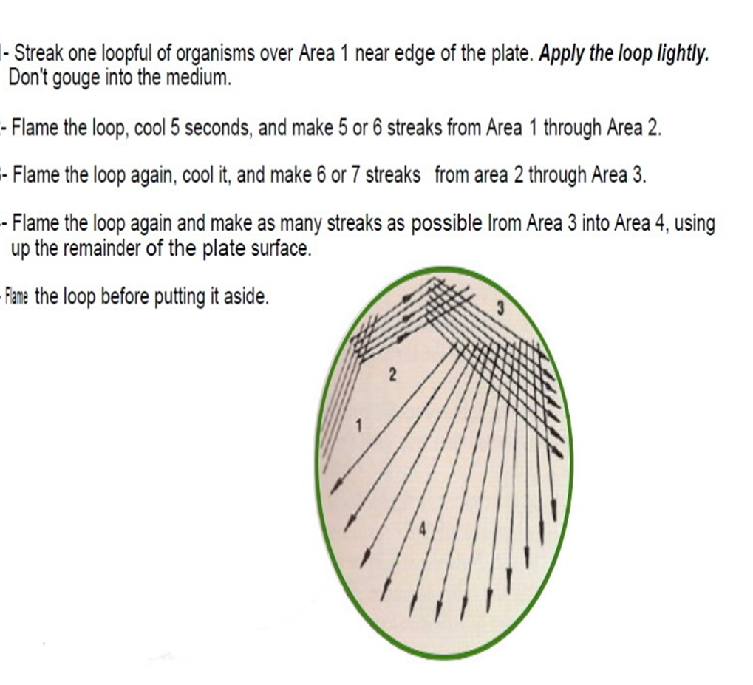
Quadrant method:

Slide 18
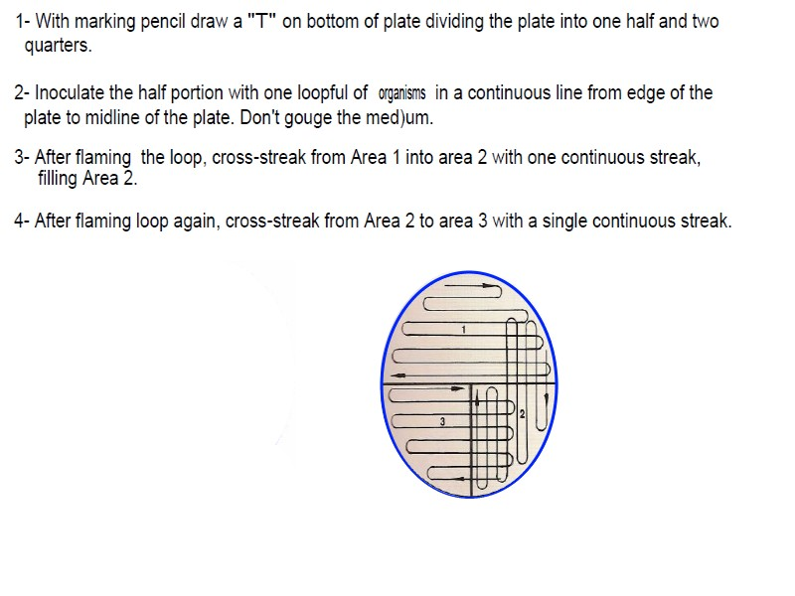
T - Streaking

Slide 19
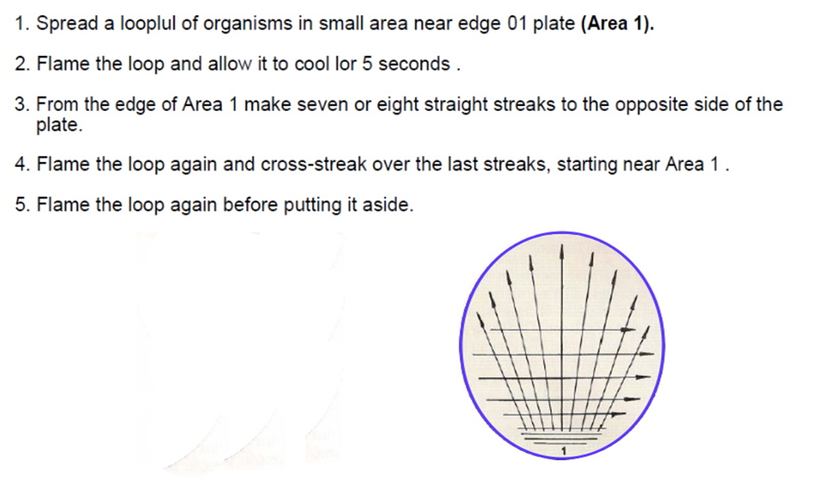
Radiant streaking

Slide 20
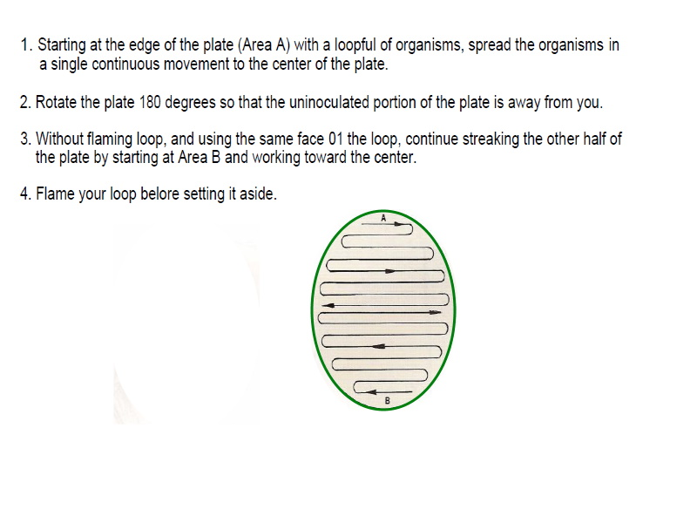
Continuous streaking

Slide 21
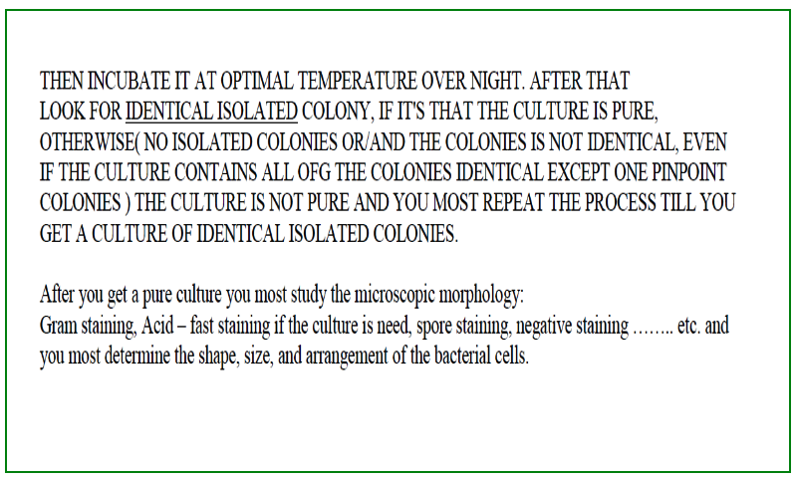

Slide 22
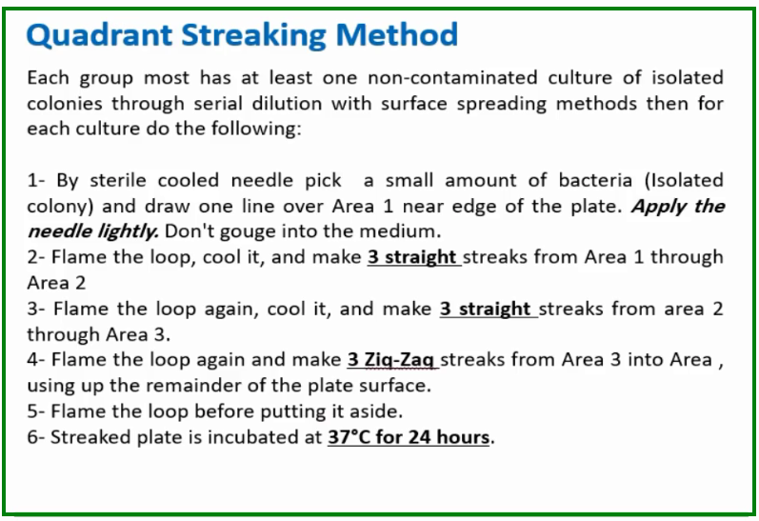

Slide 23
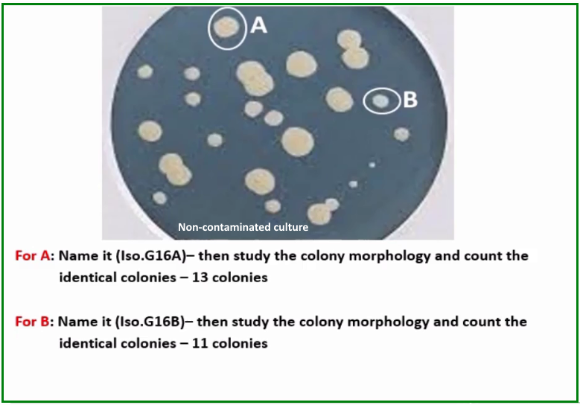

Slide 24
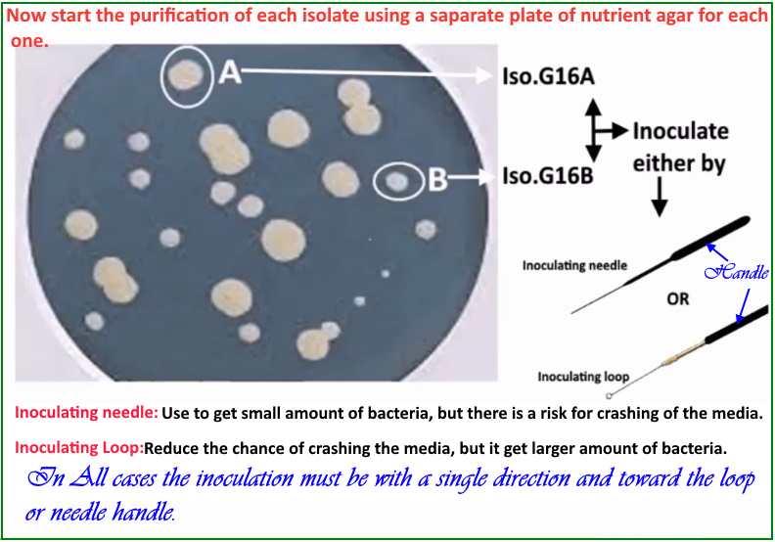

Slide 25
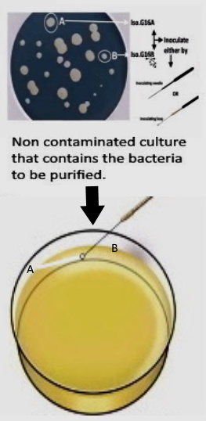
STEP 1 We need to use loop , sterilize the loop in the hottest area of the flame, cool it near the Bunsen Burner , then check the cooling of the loop by inserting it in the agar of the Non- contaminated culture , from where we will take the bacteria, and away from bacteria.
STEP 2
Inoculate the bacteria on plate “2” by single, straight, unidirectional line, from “A” toward “B”, and near the edge of the plate as will as possible.
The movement of the loop must be toward the handle of the loop to prevent crashing of the media.
Unidirectional: dilute the bacteria as we move away from the starting point.

Slide 26
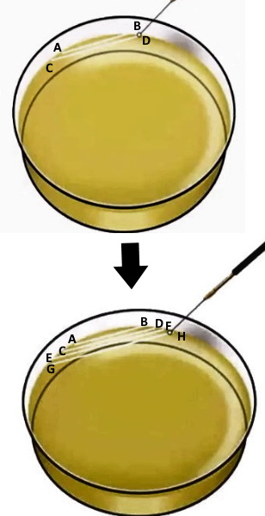
STEP: 3 After the loop reach “B”, remove it and by the same side of the loop, and without sterilization of the loop and without addition of bacteria inoculate the plate with straight unidirectional line, parallel to the first and starting from “C” toward “D”. Also, by the same side of the loop and without addition of bacteria do the other two line, “E” toward “F” and “G” toward “H”. This will make the number of bacteria to decrease, this means that the number of bacteria at A highest number of bacteria>B>C>D>E>F>G>H(theleast number of bacteria. Streaking is a dilution on a solid surface.

Slide 27
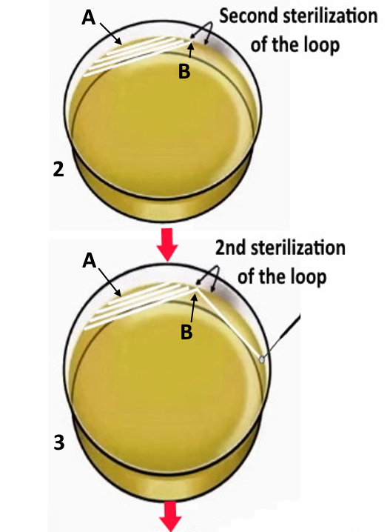
Step 4: * 2nd sterilization for the loop, flame the loop, cool it near the Bunsen Burner, then check the cooling of the loop by inserting it in the agar of plate “2” between the first inoculating line and the edge of the plate (at A ). * Then put the loop at the end area of the fourth line ( B ), and spread the bacteria by single unidirectional line near the edge of the plate as will as possible

Slide 28
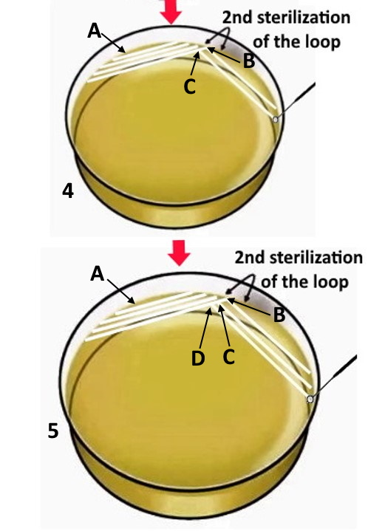
Step 5: * Then without sterilization of the loop, put the loop at “C” then spread the bacteria by unidirectional line near the edge of the plate as will as possible as you see in picture “4”. Step 6: * Also, without sterilization of the loop, put the loop at “D” then spread the bacteria by unidirectional line near the edge of the plate as will as possible as you see in picture 5. In All steps the movement of the loop must be toward its handle to prevent crashing of the media.

Slide 29
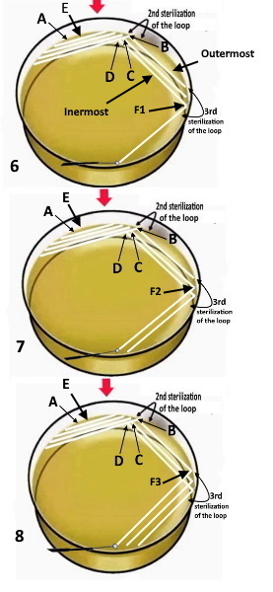
Step 7: * Sterilize the loop for the third time , cool it near the Bunsen Burner, then check the cooling of the loop by inserting it in the agar near the first time (at E). * Then spread the bacteria at the end of each line ( at F1, F2, then F3 ) by unidirectional line, near the edge of the plate as will as possible, starting from the innermost line ( at F1 ) to be the outermost line ( Picture 6 ), then middle line ( at F2 ) as you see in picture 7, and finally, the outermost line ( at F3 ) to be the innermost line as you see in picture 8. No flaming for the loop between the spreading of bacteria from F1. F2, and F3

Slide 30
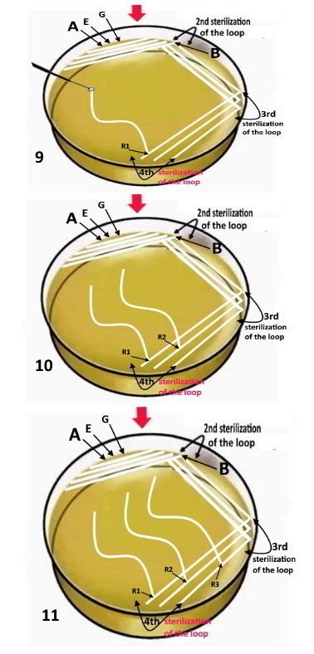
Step 8: * Then sterilize the loop again for the fourth time, cool it near the Bunsen Burner, check the cooling of the loop by inserting it to the agar of the plate near the first and second times (at G). * Spread the bacteria at R1, R2, R3 , respectively, by Zig Zag lines Starting from the innermost line as in picture 9, then middle line as in picture 10, and finally, the outermost line as in picture 11. No flaming for the loop between the spreading of bacteria from R1. R2, and R3 * Repeat steps 1 – 8 for all isolate you need to purify, each on a separate plate

Slide 31
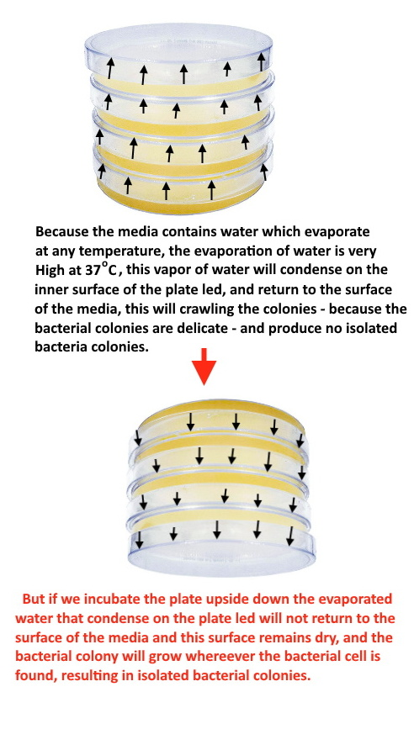
Step 9: Incubate All plates upside down over night. Why upside down?

Slide 32
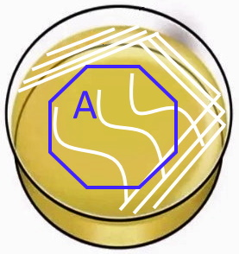
The Zig Zag line: We inoculate the bacteria by Zig Zag line to increase the area for bacterial distribution. (The Zig Zag line is longer than straight line) . The area of zig zag line ( A) is the area where the isolated colonies of bacteria will develop, this area must be as large as possible, that’s why we inoculated the plates near the edge of the plate as will as possible.

Slide 33
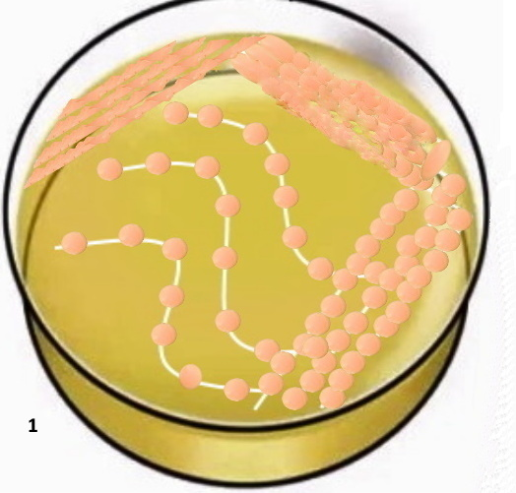
After over night incubation: The pure culture contains isolated, Identical colonies and all of them grew on the inoculated line as in (1), otherwise, the culture is not pure

Slide 34
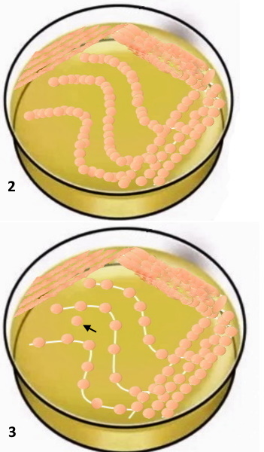
But If: 1- The bacterial colonies in the Zig zag area are not isolated as in plate “2” The culture is NOT pure. 2- The colonies in the Zig zag are isolated and identical, and grew on the inoculated except one or more of them grew out of the inoculated lines as on the tip of arrow in plate “3” , the culture is NOT pure even if the colony(ies) is (are) identical to the others.

Slide 35
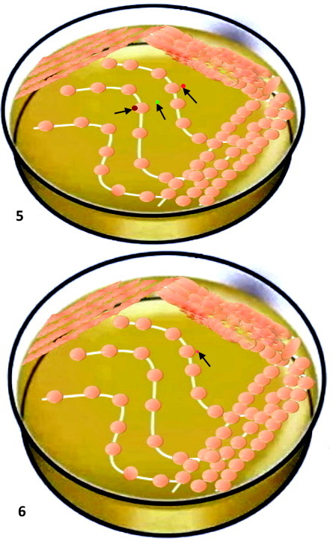
3. If the Culture contains identical, isolated colonies and all of them grew on the inoculated, but the culture contains, also, some other different colonies as in the tip of arrows at plate “5”. The culture is NOT pure. 4. If the Culture contains identical, isolated colonies and all of them grew on the inoculated except a pinpoint colony as in the tip of arrows at plate “6”. The culture is NOT pure.

Slide 36
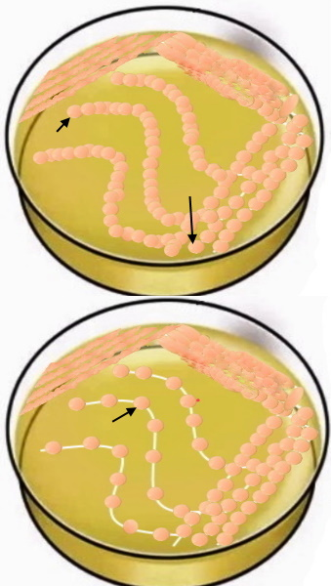
If the culture is not pure you choose a most separated colony as you see on the tips of arrows and repeat the surface streaking method by the same way. At the time of getting a pure culture study the followings: * Colony morphology * Cell morphology by doing: 1- Gram staining to identify the Gram reaction of bacteria, the shape, and the arrangement of bacterial cells. 2- Endospore staining 3- Capsule staining 4- Acid–Fast staining if the bacteria can’t stain by Gram staining

Slide 37

At the End
Incubate the plates upside down in the refrigerator to be used later.

